Slide 1




January 13, 2020
DEER PARK COMMUNITY CENTER
Joint Meeting
Deer Park City Council
Deer Park Community Development Corporation
Deer Park Parks and Recreation Commission

Slide 2
TONIGHT’S AGENDA
Review project budget & projected schedule
Updated concept plan
Discuss operational projections
Next steps
2

Slide 3
PROJECT COST SUMMARY
*
LAST MEETING
Description | Cost
All options include 12,000 sf Community Center next to city hall
36,000 sf recreation center – large gym, single story (no track) reduced room sizes | $31,000,000
42,200 sf recreation center – large gym, track, recommended room sizes | $34,000,000
48,000 sf recreation center – true double gym, track, recommended room sizes | $37,700,000
Outdoor pool renovations and replace bathhouse | $2,570,000

Slide 4
REVISED PROJECT COSTS
Description | Cost
Hard costs
Site development | $1,965,000
Community ($5.6M) and Recreation ($16.9M) Centers | $22,509,000
Outdoor pool area & bathhouse | $726,000
FF&E (furniture, fixtures & equip.) | $1,200,000
Professional services | $3,200,000
Contingencies and misc. costs | $3,400,000
Escalation, based on 5.8% annual & 6/2021 start | $7,200,000
Total project cost | $40,200,000

Slide 5
PROJECTED PROJECT SCHEDULE
~6/2020
~7/2021
Design
~ 3 months
~ 4 months
~ 4 months
~13 Months
Schematic Design
Design Development
Construction Documents
Bidding
2 Months
~9/2021
~2/2024
Construction
~ 12 months
~ 3 mo.
~ 14 months
~29 Months
PHASE 1
Community Center
Abatement & Demolition
PHASE 2
Recreation Center

Slide 6
TONIGHT’S AGENDA
Review project budget & projected schedule
Updated concept plan
Discuss operational projections
Next steps
6

Slide 7
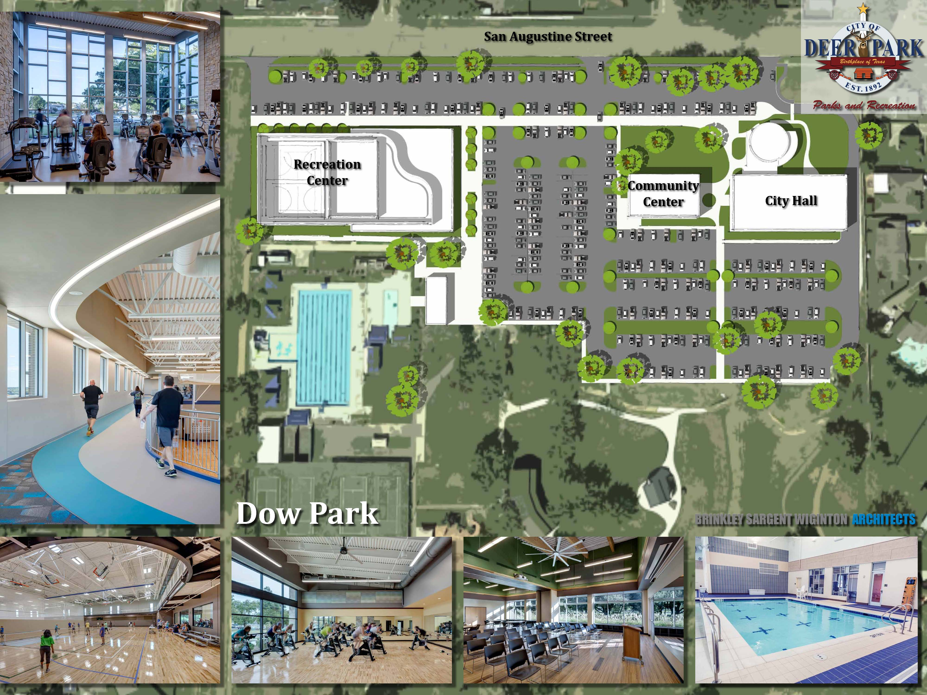
CONCEPT PLAN

Slide 8
TONIGHT’S AGENDA
Review project budget & projected schedule
Updated concept plan
Discuss operational projections
Next steps
8

Slide 9
Operational Projections
Methodology for Developing the Business Plan
Current Recreation Budget
Community Center Staffing Levels/Financial Plan
Community Center Financial Plan
Recreation Center Assumptions
Recreation Center Financial Plan
Overall Financial Plan
Questions

Slide 10
Total Cost of Ownership Concept
Capital Investment
Operations and Maintenance
Lifecycle Replacement
Total Cost of Ownership

Slide 11
Operations and Maintenance Costs
Community Center Operations
Recreation Center Operations
Existing Recreation
Total Cost of Operations

Slide 12
Cost Recovery Approach
All Revenue
All Expenditures
Total Cost Recovery Percentage

Slide 13
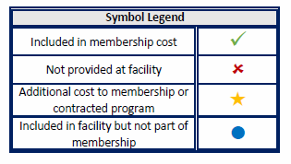
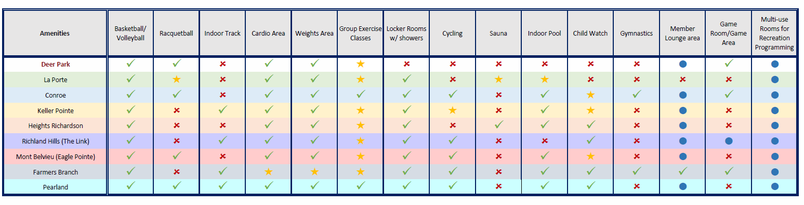
COST RECOVERY – AMENITY COMPARISONS
*
* Currently contemplating a new facility or major expansion.
13

Slide 14
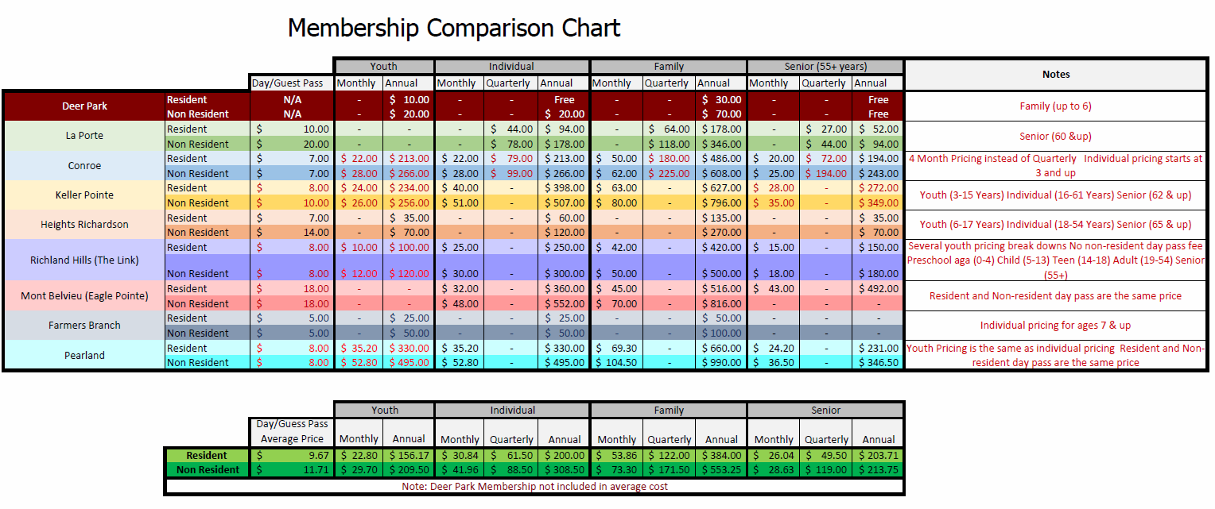
COST RECOVERY – MEMBERSHIP COMPARISONS
14

Slide 15
Current Recreation Budget - Summary
Revenue Assumption:
$523,000 = Current Revenue
After School Activity Program = $395,000
Outdoor Aquatics = $108,000
Athletic Programs = $5,000
Recreation Programs = $15,000
Expenditure Assumption:
$2,742,341 = 100% of Recreation Expenditures

Slide 16
Projected Community Center Staffing Levels
Recreation Specialist – 1 FT (Existing)
Part-time Staff
Rentals
Maintenance
Recreation Programs

Slide 17
Projected Community Center Pro Forma

Slide 18
Projected Recreation Center Operating Hours
Monday – Friday: 5:30am - 10pm
Saturday: 7:00am - 8:00pm
Sunday: 9:00am - 5:00pm
103.5 hours per week
Holiday Hours will vary depending upon the holiday from being closed to reduced hours.

Slide 19
Projected Full time Staffing Levels (5 Total; 3 Existing)
Recreation Center Facility Manager – (1) - Existing
Recreation Program Supervisor – (1) - Existing
Aquatics Specialist – (1) - NEW
Facility Maintenance Supervisor – (1) - Existing
Facility Maintenance Worker – (1) - NEW

Slide 20
Projected Part-time Staffing Levels
Customer Service Specialists – 10,000 labor hours annually
Custodial Attendants – 1,650 labor hours annually
Aquatics - Lifeguards – 10,000 labor hours annually
Fitness Center Supervision – 5,000 labor hours annually

Slide 21
Recreation Center Membership/Daily Admission Includes:
Unlimited use of the Center during all open recreaiton times *Reduced rates on programs and facility rentals *Priority registration on most programs/classes
Unlimited use of the Center during all open recreation times
Priority registration on most programs/classes
Group Exercise Programs NOT INCLUDED in price of membership/daily admission.
Child Watch for children ages 2-12 will be discounted for members of the Recreation Center
Child Watch is defined as up to 2 hours of babysitting while adult is utilizing the facility
Hours for Child Watch will be posted separately – morning and evening hours will be available.

Slide 22
Projected Membership Fees

Slide 23
Projected Recreation Center Pro Forma

Slide 24
Community Center and Recreation Center Combined Pro Forma
PROJECTION: Annual general fund subsidy for the operations of the new Community Center and Recreation Center will require a general fund subsidy in the first year of full operations of $174,407.

Slide 25
Current vs Projected Annual Recreation Operating Budget
PROJECTION: Annual general fund subsidy will decrease by $887,593 as compared to the current operations of the Recreation Division

Slide 26


Slide 27


NEXT STEPS

Slide 28

PROJECTED CENTER OPERATING HOURS
Monday - Friday: 5:30 AM – 10 PM
Saturday: 7 AM – 8 PM
Sunday: 9 AM – 5 PM
103.5 hours per week
Holiday Hours will vary depending upon the holiday from being closed to reduced hours.

Slide 29

PROJECTED FULL TIME STAFFING LEVELS
Existing
New proposed
Director
Assistant Director
Administrative Coordinator
Secretary
Recreation Supervisor
Recreation Specialist (2)
Youth Program Coordinator
Marketing/Tech Coordinator
Athletics/Aquatics Supervisor
Athletics/Aquatics Coordinator
Recreation Specialist - Athletics/Aquatics
Aquatic staff member - NEW
Building maintenance staff member - NEW
2 additional
12 total

Slide 30

GYMNASIUM AND INDOOR POOL ASSUMPTIONS
Gymnasium and Indoor Pool
will be utilized for both programming and open use
In addition to Normal Operating Hours,
schedules for Gymnasium and Indoor Pool will be posted and vary based on time of year.

Slide 31
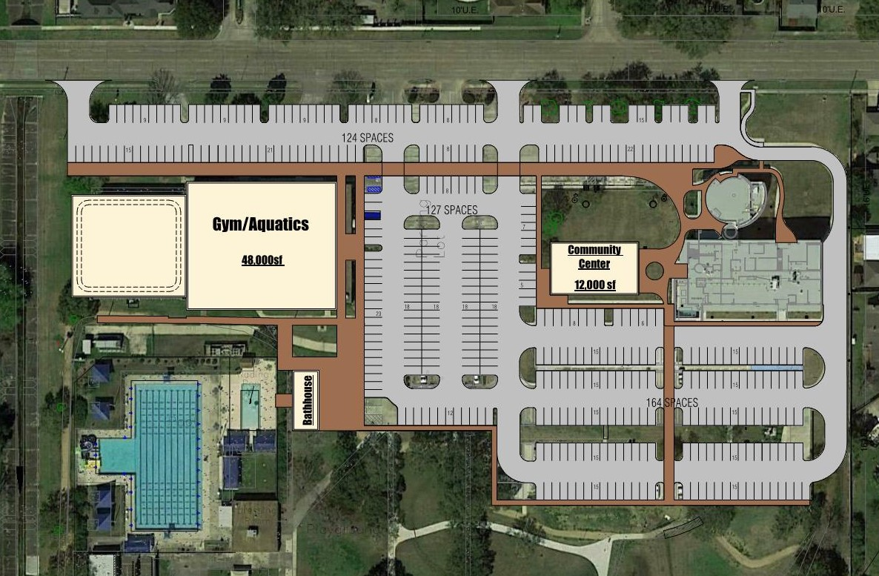
NEW CENTERS - $37.7M OPTION
*
DOES NOT INCLUDE OUTDOOR POOL
~48,000 sf
Recreation Center
Incl. 15,000 sf gymnasium w/ 2 full-size courts
Incl. track
31

Slide 32
OUTDOOR POOL AREA SCOPE DESCRIPTION
~$2.57M
Replace bath house
Repairs and maintenance updates to pool as recommended by audit
Related site improvements
32

Slide 33
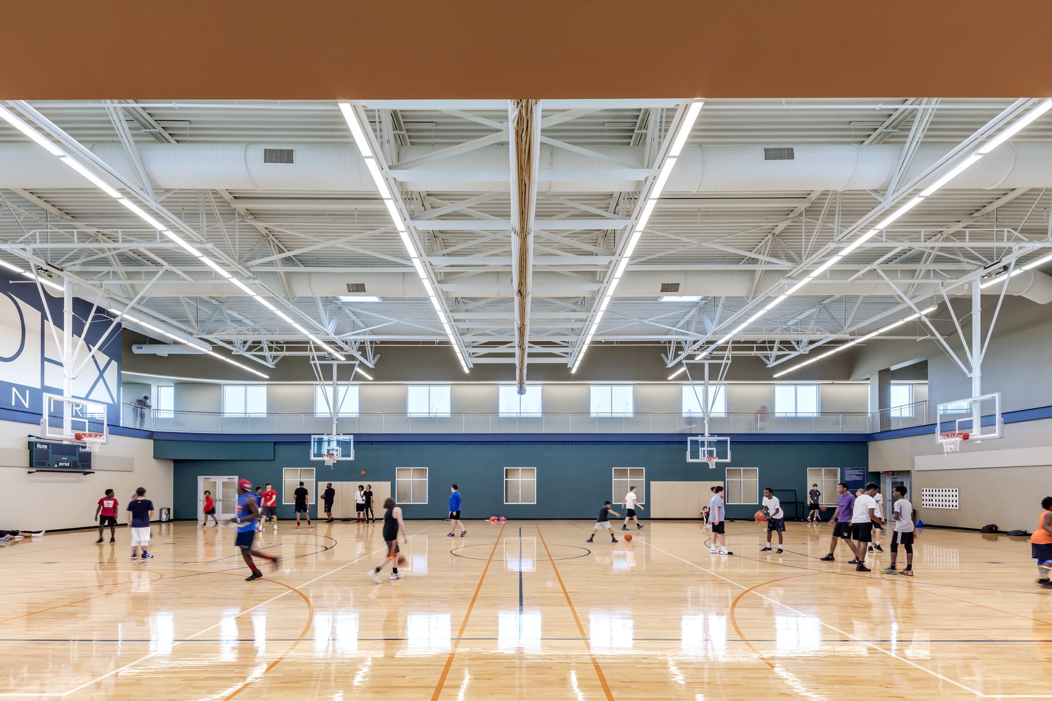
EXAMPLE 10,000 SF GYMNASIUM
33

